Slide 1
Database Development & Design
Entity Relationship (ER) MODEL

Slide 2
Outline
ER Model
Data Models in DBMS
Design Process
Conceptual Model
ER Model components
ER Notations
DBMS Scenario

Slide 3
ER Model
An entity relationship diagram (ERD) is a diagram that defines the structure of database instances.
An Entity Relationship (ER) Diagram is a type of flowchart that illustrates how “entities” such as people, objects or concepts relate to each other within a system.
ER Diagrams are most often used to design or debug relational databases in the fields of software engineering, business information systems, education and research.
Depending on the levels of data we are modeling, we have divided data models into 3 categories:
  Conceptual Model
  View Model (logical model)
  Physical model

Slide 4
Data Models in DBMS (schema in DBMS)
Conceptual Model - High-level:
  It is high level design. What entities should exist and the connections between them. In this phase you recognize the entities in your model and the relationships between them.
Logical Model:
  A logical data model describes the data in as much detail as possible, without regard to how they will be physical implemented in the database. Logical model include:
    All entities and relationships among them.
    Resolves M:N relationships.
    All attributes for each entity are specified.
    The primary and foreign keys for each entity is specified.
    Create normalized business rules.
Physical Model - Low-level:
  Represents how the model will be built in the database.
  Shows all entity structures, attribute data type, attribute constraints, primary key, foreign key, and relationships.

Slide 5
Data Models in DBMS (schema in DBMS)
The three levels of data modeling (conceptual, logical, physical) were discussed in prior slide. The table below compares the different features:
Feature | Conceptual | Logical | Physical
Entity Names | ✓ | ✓ | ✓
Entity Relationships | ✓ | ✓ | ✓
Attributes |  | ✓ | ✓
Primary Keys |  | ✓ | ✓
Foreign Keys |  | ✓ | ✓
Attribute constraints |  |  | ✓
Attribute Data Types |  |  | ✓

Slide 6
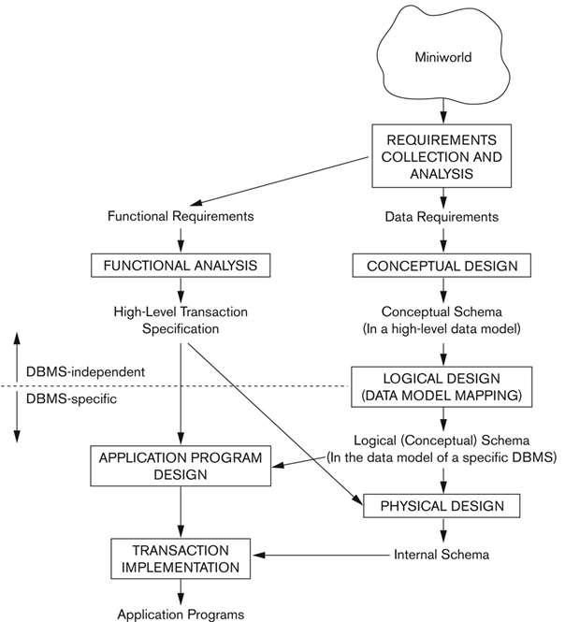
Overview of Database Design Process

Slide 7
Database Design Process
Main phases of database design:
Requirements collection and analysis:
    Database designers interview prospective database users to understand and document data requirements
    Result:
      Data requirements.
      Functional requirements of the application consist of the user defined operations (or transactions) that will be applied to the database, including both retrievals and updates.

Slide 8
Database Design Process
  Creating a Conceptual schema for the database, using a high-level conceptual data model.
      This step is called: Conceptual design
      Description of data requirements:
          Includes detailed descriptions of the entity types, relationships, and constraints
          Because these concepts do not include implementation details, they are usually easier to understand and can be used to communicate with nontechnical users.
      The high-level conceptual schema can also be used as a reference to ensure that all users’ data requirements are met and that the requirements do not conflict.
      This approach enables database designers to concentrate on specifying the properties of the data, without being concerned with storage and implementation details.
      This makes it is easier to create a good conceptual database design.

Slide 9
Database Design Process
  Logical design or data model mapping:
      The next step in database design is the actual implementation of the database, using a commercial DBMS. Most current commercial DBMSs use an implementation data model—such as the relational or the object-relational database model.
      In this step the conceptual schema is transformed from the high-level data model into the implementation data model.
      Result is: a database schema in implementation data model of DBMS

Slide 10
Database Design Process
  Physical design phase
      Internal storage structures, file organizations, indexes, access paths, and physical design parameters for the database files specified
      In parallel with these activities, application programs are designed and implemented as database transactions corresponding to the high-level transaction specifications.

Slide 11
Build the Conceptual Schema
To build the conceptual schema for any database requirements using the ER model, we need to identify four main concepts (elements)
  The set of possible entities
  The set of possible relationships between entities
  The possible constraints for each relationship

Slide 12
ER model in DBMS
Entity:
  Represents a real-world object or concept that are represented in the database.
  Rectangles are used to represent the entity in the diagram. Name of the Entity is written inside the rectangle.
  An entity may be an object with a physical existence (for example, a particular person, car, house, or employee) Or it may be an object with a conceptual existence (for instance, a company, a job, or a university course)

Slide 13
ER model in DBMS
Attribute: attributes are the describing characteristics or properties that define all items pertaining to a certain category applied to all cells of a column.
  Simple attribute: are atomic values, which cannot be divided further; For example, SSN or Sex.
  Composite attribute: are made of more than one simple attribute; For the example the Address attribute of the EMPLOYEE entity can be subdivided into (Street_address, City, State, and Zip)
  Derived attribute: are the attributes that do not exist in the physical database, but their values are derived from other attributes present in the database. For example, the value of Age can be determined from the current (today’s) date and the value of that person’s Birth_date.

Slide 14
ER model in DBMS
  Multi-value attribute: Multi-value attributes may contain more than one values. For the example a College_degrees attribute for a person: one person may not have a college degree, another person may have one, and a third person may have two or more degrees.
  Complex attribute: multi-value attribute and composite attribute.
  Primary Key attribute : An underline to the attribute name is put to represent the primary key (example Student_ID).
  Relationship attribute: a relation can have attribute. Most relationship attributes are used with M:N relationships (example: #ofHours the employee worked on a project).

Slide 15
ER model in DBMS
A key attribute may be composite.
    VehicleTagNumber is a key of the CAR entity type with components (Number, State).
An entity type may have more than one key.
    The CAR entity type may have two keys:
        VehicleIdentificationNumber (popularly called VIN)
        VehicleTagNumber (Number, State), aka license plate number.

Slide 16
ER model in DBMS
Relationship:
  A relationship relates two or more distinct entities with a specific meaning.
  For example, EMPLOYEE John Smith works on the ProductX PROJECT, or EMPLOYEE Franklin Wong manages the Research DEPARTMENT.
  Relationships of the same type are grouped or typed into a relationship type.
  For example, the WORKS ON relationship type in which EMPLOYEEs and PROJECTs participate, or the MANAGES relationship type in which EMPLOYEEs and DEPARTMENTs participate.

Slide 17
Relationship Type vs. Relationship Set
Relationship Type (role name):
  Is the schema description of a relationship
  Identifies the relationship name and the participating entity types
  Also identifies certain relationship constraints
Relationship Set:
  The current set of relationship instances represented in the database
  The current state of a relationship type
Each instance in the set relates individual participating entities – one from each participating entity type

Slide 18
E-R model in DBMS
Cardinality:
  cardinality specifies how the number of occurrences of one object are related to the number of occurrences of another object (1:1, 1:N, M:N).

Slide 19
Constraints on Relationships Types
  Cardinality (maximum): Specifies maximum number of relationship instances that entity can participate in:
    One
    Many
  Participation (minimum): Specifies whether existence of entity depends on its being related to another entity via the relationship type
    zero (optional participation, not existence-dependent, partial)
    One (mandatory participation, existence-dependent, total)

Slide 20
Recursive Relationship Type
A relationship type between the same participating entity type in distinct roles
Also called a self-referencing relationship type.
Example: the SUPERVISES relationship
Example: Each relationship instance relates two distinct EMPLOYEE entities:
    One employee in supervisor role
    One employee in supervisee role

Slide 21
Entity vs. Entity Type vs. Entity Set
Entity type:
  Entities with the same basic properties are grouped or typed into an entity type (the category of a particular entity).
  For example, the entity types: employee, department, project.
Entity:
  Entity is a basic concept for the ER model. Entities are specific things or objects in the mini-world that are represented in the database.
  For example, the employee John Smith, the Research department, the ProductX project.
Entity Set:
  Each entity type will have a collection of entities stored in the database.
  Entity set is the current state of the entities of that type that are stored in the database.

Slide 22
Entity vs. Entity Type vs. Entity Set
The whole table called entity type
Employee table
First name | last name | SSN
John | Smith | 9925202152
Mary | Kadin | 6956525212
Allis | Edward | 2202021254
The three rows together named entity set
The first row individually named entity
The second row individually named entity
The third row individually named entity

Slide 23
ERD Notations in Data Modeling
Different Notations
  Barker’s Notation
  Chen Notation
  IDEF1X Notation
  Arrow Notation
  UML Notation
  Crow’s Foot Notation; we will use in this course.

Slide 24
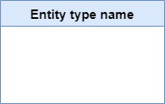
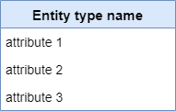
Notations for ER Diagrams
Entity type:
Attributes

Slide 25
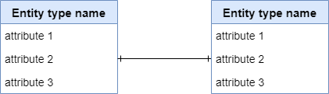
Notations for ER Diagrams
Relationship:
  One-to-one relation (1:1)

Slide 26

ERD Notations
Relationship:
  One-to-many relation (1:M)

Slide 27

ERD Notations
Relationship:
  Many-to-many relation (M:M)

Slide 28
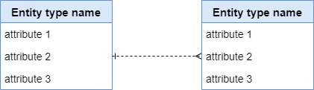
Shapes of E-R Diagram
Note: in the conceptual design part, we don’t focus on strong/weak relationships. We will focus on it in the logical design part.
Strong relationship
Strong Entity
Weak Entity
Strong Entity
Strong Entity
Weak relationship

Slide 29
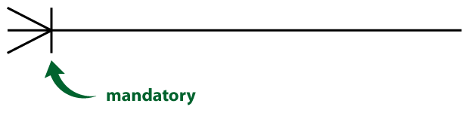


Shapes of E-R Diagram
Optional relationship
The symbol indicating whether the relationship is mandatory or optional.
Customer may have many sales. It is permissible to have a customer with no associated sale records.
Place

Slide 30
Bank Management System Example
Scenario:
The bank has many branches. Each branch consists of multiple departments, and each department includes many employees. The employee should work in one department. An employee can make many transactions. Each transaction is performed on one account. Note: the account may have multiple transactions. In addition, the account is owned by one or more customers and customers can have multiple accounts. There are many account types like (saving, checking, and money market accounts). For each account, there is one account type. Customers can visit multiple branches.

Slide 31
Bank Management System Example
We should follow the below steps to be done with the ERD:
  Identify the entities
  Identify the relationships and cardinalities
  Conceptual design
  Identify the attributes
  Schema and mapping
  Normalization
  Logical design
  Physical design

Slide 32
Bank Management System Example
Scenario:
The bank has many branches. Each branch consists of multiple departments, and each department includes many employees. The employee should work in one department. An employee can make many transactions. Each transaction is performed on one account. Note: the account may have multiple transactions. In addition, the account is owned by one or more customers and customers can have multiple accounts. There are many account types like (saving, checking, and money market accounts). For each account, there is one account type. Customers can visit multiple branches.

Slide 33
Bank Management System Example
  Entities:
  Branch
  Employee
  Department
  Transaction
  Account
  Customer
  Account type

Slide 34
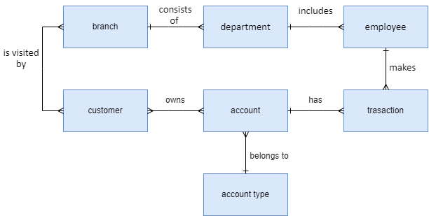
Conceptual Model

Slide 35
Company Example
Scenario:
The company is organized into departments. Each department has an employee who manages the department. Each department controls a number of projects. Each employee works for one department but may work on several projects. Each employee may have a number of dependents.

Slide 36
Company Example
Scenario:
The company is organized into departments (N:M). Each department has an employee who manages the department (N:N). Each department controls a number of projects(N:M). Each employee works for one department but may work on several projects(N:M). Each employee may have a number of dependents(N:M).

Slide 37
Company Example
  Entities:
  Department
  Employee
  Project
  Dependent

Slide 38
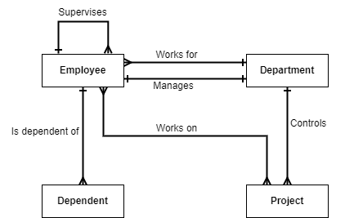
Conceptual Model

Slide 39
References
Elmasri, R., & Navathe, S. (2017). Fundamentals of database systems (Vol. 7). Pearson
Eng. Lina’s slides
Dr. Raneem’s slides.

